Slide 1
Large-Scale and Multi-Structured Databases Project Design Second Chance
Adelmo Brunelli, Martina Marino, Roberta Matrella

Slide 2
Application Highlights
SecondChance is an e-commerce in which users have the possibility of buying and selling vinted or new items.
An unregistered user can only sign up and then sign in.
A registered user can:
Sign in in the application
Visualize home
Visualize viral insertions
Visualize feed
Visualize his/her profile
Visualize personal information
Browse his/her insertions
Visualize insertions he/she is interested in
Browse his/her orders
Visualize followers and following users
Add credit to the personal balance account
The administrator is able to:
Visualize statistics
Suspend a user
Delete an insertion
Create a new insertion
Delete an insertion of your own
Search insertions by seller, brand or using filters
Visualize an insertion
Like an insertion
Buy relative item
Search a user
Follow/unfollow a user
Visualize suggested users
Logout from the application

Slide 3
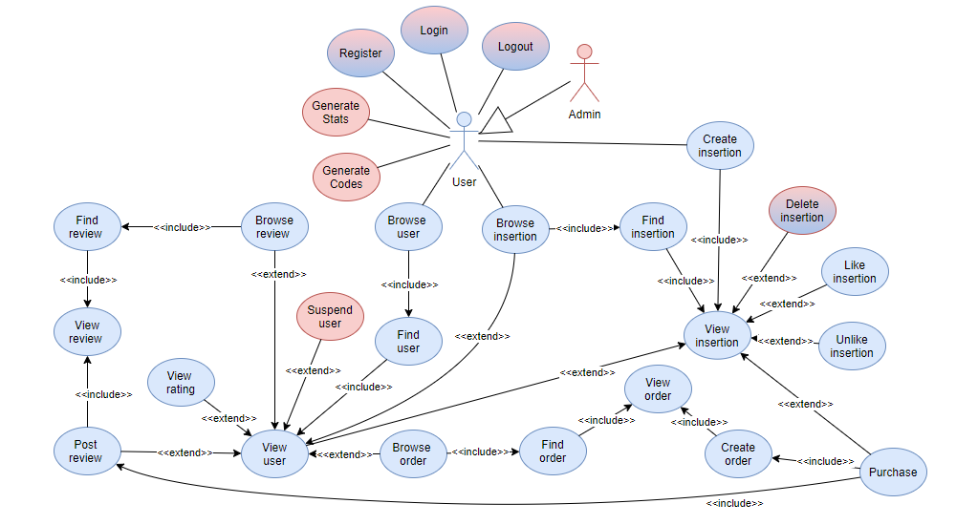
Actors and main supported functionalities
Notes:
Those with the gradient are the actions that can be done by both

Slide 4
Dataset Description
Source:
https://www.kaggle.com/asmaoueslati/womensclothingecommerce (reviews)
https://data.world/wordlift/shopping-demo/workspace/file?filename=amazon-fashion.csv (items)
https://data.world/jfreex/products-catalog-from-newchiccom (items)
https://data.world/promptcloud/amazon-australia-product-listing/workspace/project-summary?agentid=promptcloud&datasetid=amazon-australia-product-listing (items)
https://generatedata.com/generator (users)
Description: The first has all the information regarding the reviews. The second and the third datasets contain all the items with relative details and links of the images. Users were randomly generated online.
Volume: ~ 50 MB (~ 15.000 review, ~ 100.000 users, ~ 120.000 items,
~ 15.000 orders, ~ 1.000 codes, ~ 100.000 balances)
Variety: The final dataset is a merged version of the different sources. They were managed to correctly match data.

Slide 5
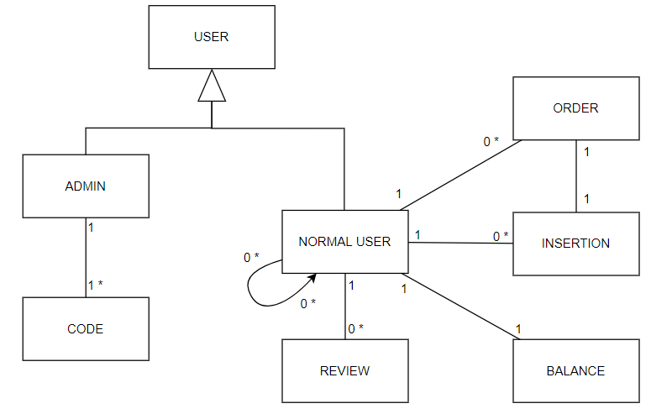
Preliminary UML Class Diagram
Notes:
Non cancelliamo l’inserzione
We maintain order information into normal user collection.
Insertion is a document (è un documento a se)
Admin non va nella collezione di user in mongoDB

Slide 6
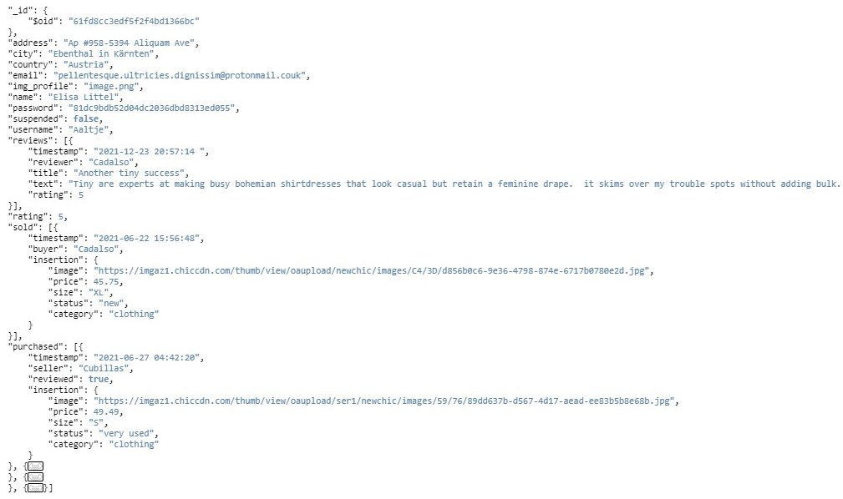
Entities handled by Mongo DB
User
Notes:
In the user collection we have an array for purchases and an array for orders.
In user page we will have a button that will lead to reviews to see user’s rating (avg of reviews).

Slide 7
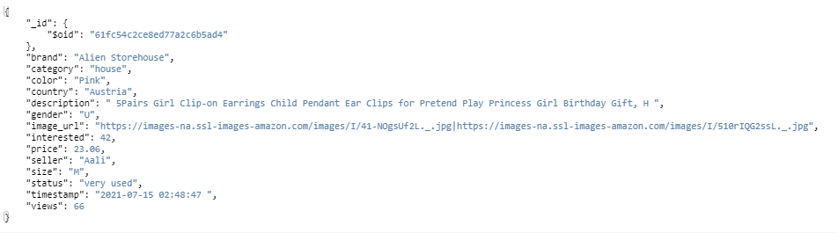

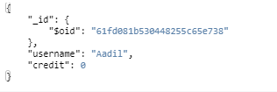
Entities handled by Mongo DB
Insertion
Code
Balance
Notes:
In the user collection we have an array for purchases and an array for orders.
In user page we will have a button that will lead to reviews to see user’s rating (avg of reviews).

Slide 8
Entities handled by Mongo DB
Notes:
In the user collection we have an array for purchases and an array for orders.
In user page we will have a button that will lead to reviews to see user’s rating (avg of reviews).

Slide 9
Queries on Mongo DB
Search insertions by seller, brand or filters
Search user by username or filters
Get viral insertions
Top k rated users by country
Top k users with more purchased items
Top k users with more sold items
Top k interesting insertions by category
Top k viewed insertions by category

Slide 10
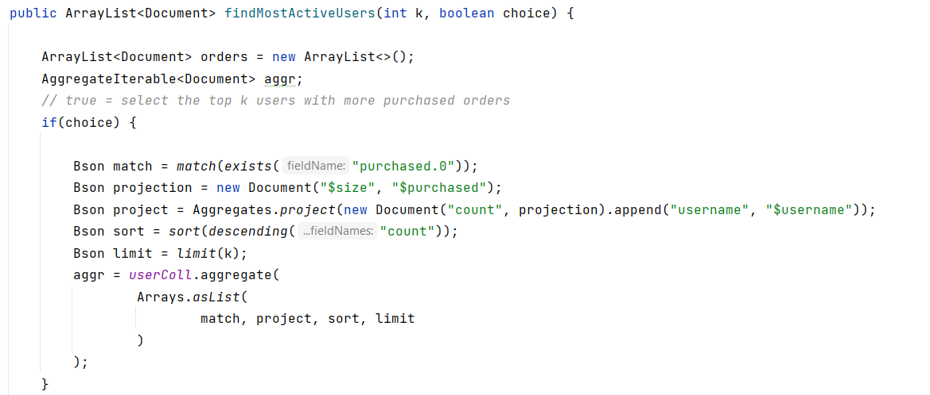
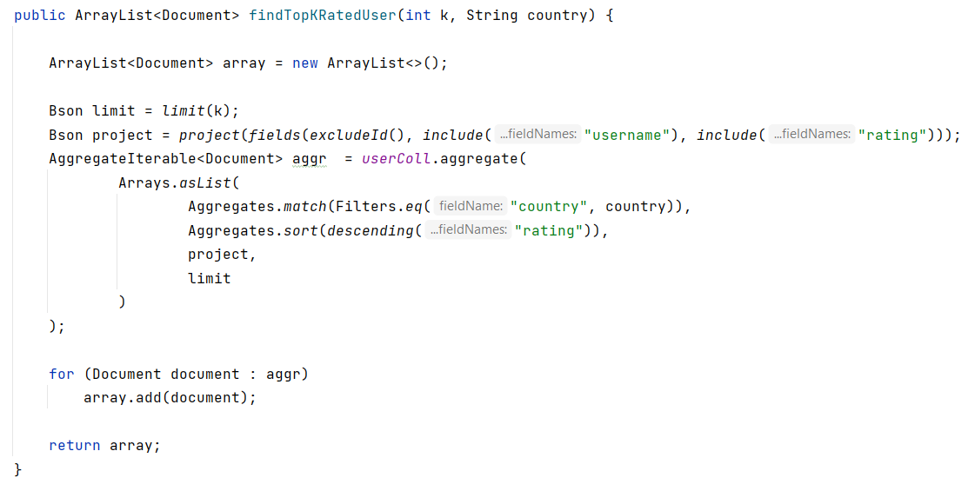
Queries on Mongo DB

Slide 11
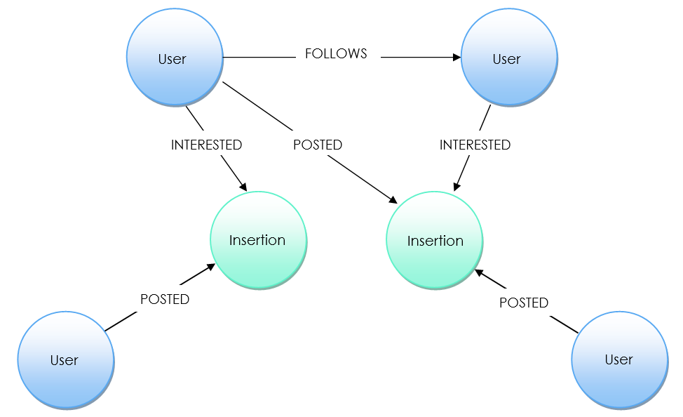
Entities handled by Neo4j
Entities
User:
username
country
Insertion:
uniq_id
category
Relationships
(u:User)-[:POSTED]->(i:Insertion)
(u:User)-[:FOLLOWS]->(v:User)
(u:User)-[:INTERESTED]->(i:Insertion)
Notes:
Gli utenti vengono suggeriti in base agli utenti seguiti, location e rating.
Le inserzioni vengono suggerite in base ai parametri simili di ricerca, location, like.
Likes with timestamps
Quando si inserisce un’inserzione nel graph DB si crea un arco tra inserzione e l’utente che l’ha generata
Mostra inserzioni dell’utente con mongoDB
Following, followed, suggested and interested sono archi

Slide 12
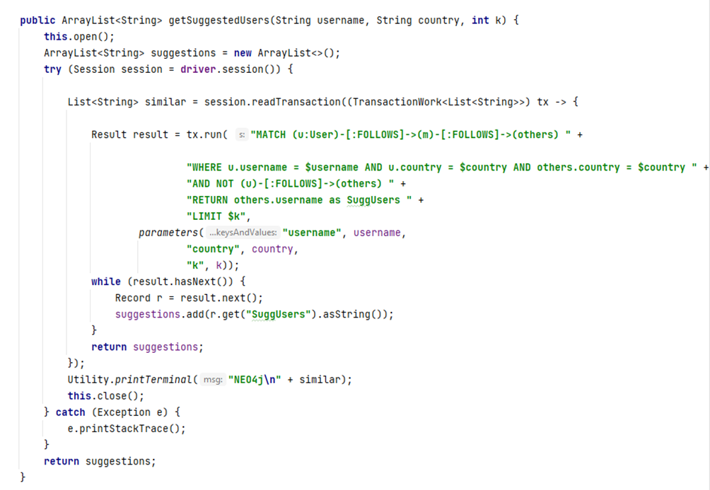
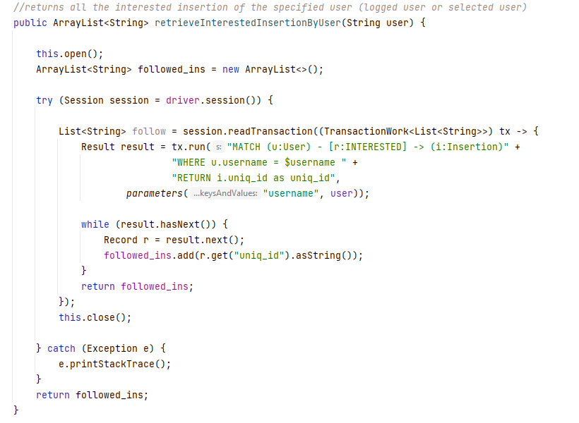
Queries on Graph DB
Suggest new sellers based on the same country and followers
Suggest new insertions based on similar interested insertions and category
Get the k insertions posted by the followers of a specific user
Show to the admin the amount of like per category
Notes:
Gli utenti vengono suggeriti in base agli utenti seguiti, location e rating.
Le inserzioni vengono suggerite in base ai parametri simili di ricerca, location, like.
Likes with timestamps
Quando si inserisce un’inserzione nel graph DB si crea un arco tra inserzione e l’utente che l’ha generata
Mostra inserzioni dell’utente con mongoDB
Following, followed, suggested and interested sono archi

Slide 13
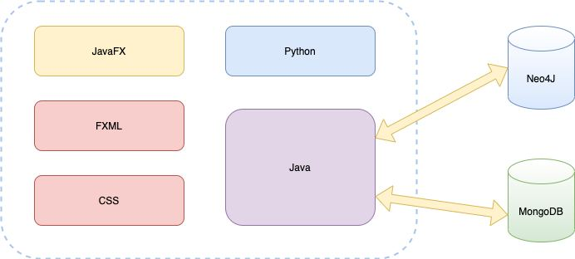
Software Architecture Preliminary Idea
Programming languages:
Java
JavaFX
FXML
Python
CSS
DBMSs:
MongoDB
Neo4J
Frameworks:
Maven

